Slide 1
CaliFormer: Leveraging Unlabeled Measurements to Calibrate Sensors with Self-supervised Learning
Haoyang Wang¹, Yuxuan Liu¹, Chenyu Zhao¹, Jiayou HE², Wenbo Ding¹, Xinlei Chen¹
¹Shenzhen International Graduate School, ²Hong Kong University of Science and Technology
Notes:
Good afternoon, professors and classmates. My name is Haoyang Wang, I come from Lab 2C. Today, on behalf of the other members of our group, Yuhan Cheng and Baining Zhao, I would like to introduce our work on sensor calibration: CaliFormer: Leveraging Unlabeled Measurements to Calibrate Sensors with Self-Supervised Learning. This work takes advantage of Self-Supervised Learning technology, which can effectively reduce sensor measurement errors training with only 1% of labeled data compared to state-of-the-art works. We argue that this work constitutes a tangible advancement toward practical in-field sensor calibration.

Slide 2
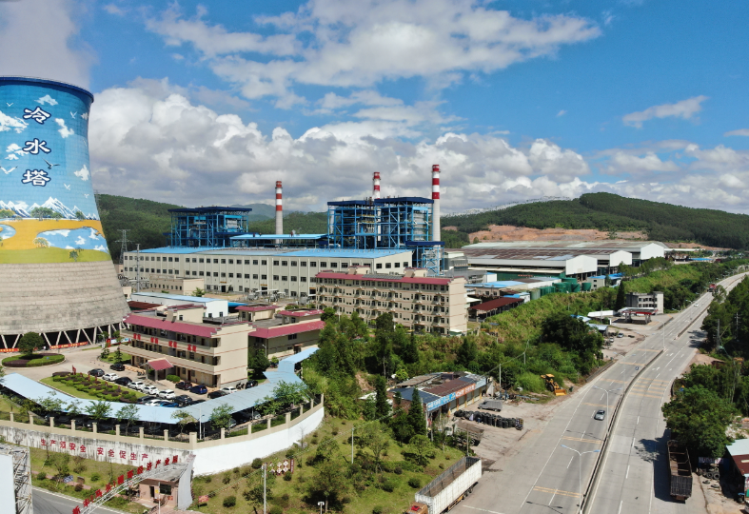
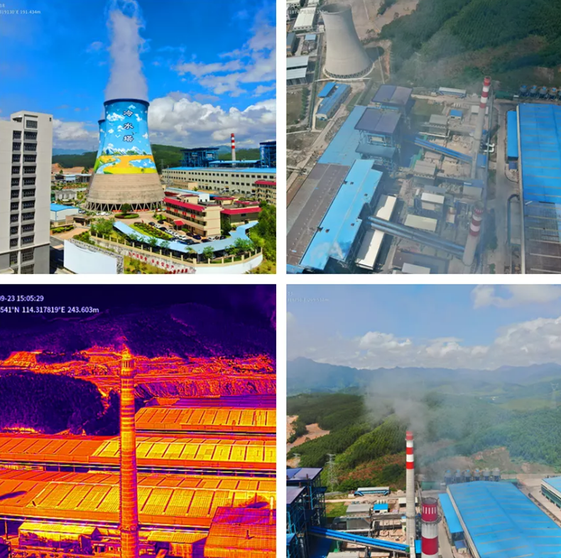
Background | Existing Methods | Insight ! | Framework Design | Experiments | Take away message
Air Pollution Takes Away a lot of lives
In 2019, air pollution caused 4.2 million deaths worldwide [1]
[1] https://www.who.int/zh/news-room/fact-sheets/detail/ambient-(outdoor)-air-quality-and-health
Notes:
As we know, air pollution has took away many lives in recent years. This is because, due to phenomena such as improper combustion of fossil fuels, harmful gases are released into the atmosphere without treatment. After humans inhale harmful gases, the incidence of lung diseases has increased significantly. According to the World Health Organization, air pollution has caused 4.2 million deaths worldwide in 2019 alone.

Slide 3
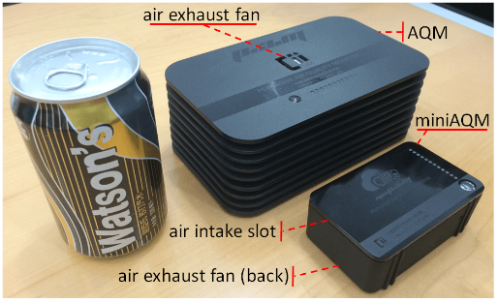
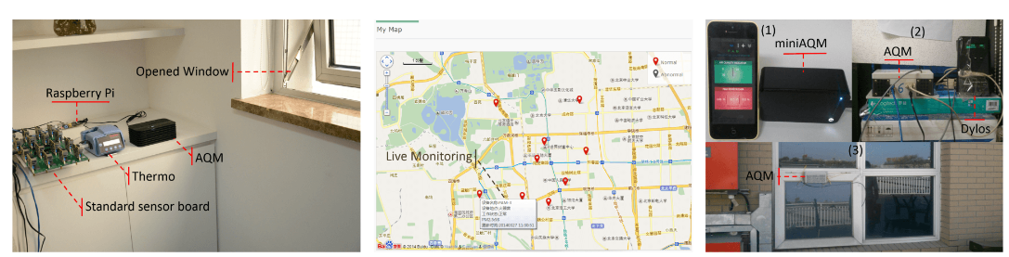
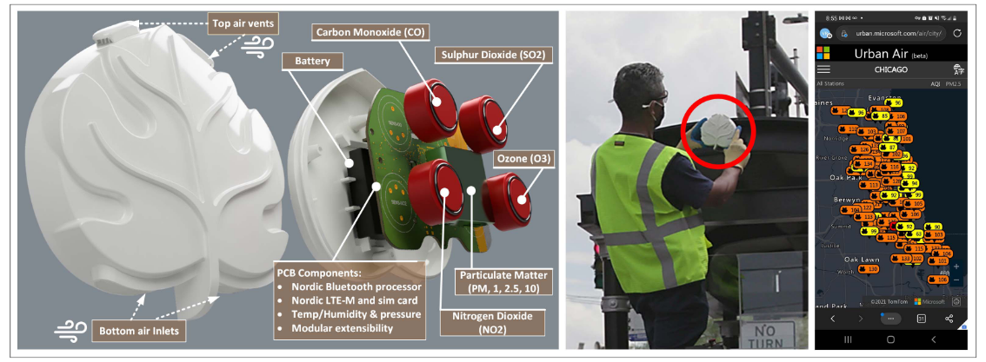
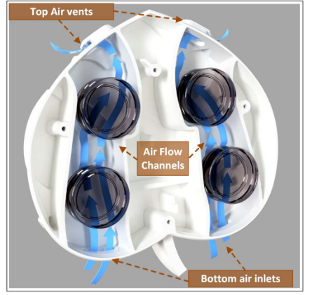
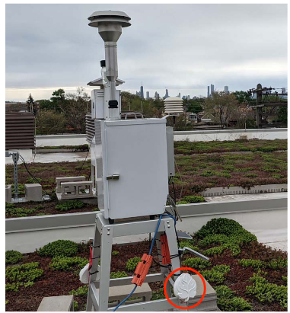
Background | Existing Methods | Insight ! | Framework Design | Experiments | Take away message
Response: Environment Monitoring
Design specific sensors to monitor the quality of air
Cheng Y, Li X, Li Z, et al. AirCloud: A cloud-based air-quality monitoring system for everyone[C]//Proceedings of the 12th ACM Conference on Embedded Network Sensor Systems. 2014: 251-265.
Daepp M I G, Cabral A, Ranganathan V, et al. Eclipse: an end-to-end platform for low-cost, hyperlocal environmental sensing in cities[C]//2022 21st ACM/IEEE International Conference on Information Processing in Sensor Networks (IPSN). IEEE, 2022: 28-40.
Notes:
In response to the harm caused by air pollution, in recent years, some sensor systems for environmental perception have been proposed to monitor changes in air quality in real time. Such as AirCloud system published on SenSys and Eclipse system published on IPSN, these conferences are top-rank conferences in embedding sensing system.
Specifically, these specially-designed sensors are deployed in different locations of the city to collect air pollution data and generate targeted air pollution warnings to effectively reduce the damage caused by air pollution.

Slide 4
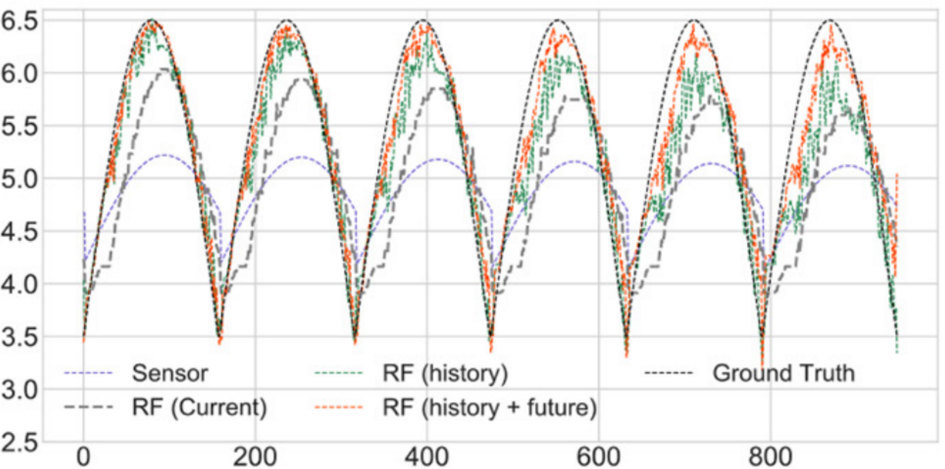
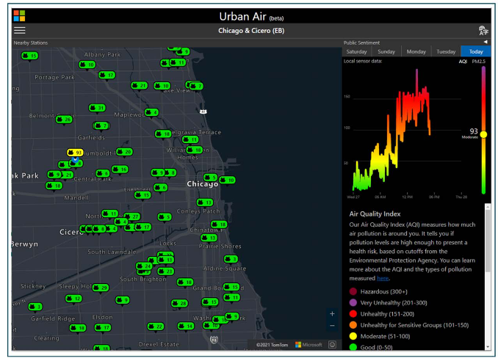

Background | Existing Methods | Insight ! | Framework Design | Experiments | Take away message
Key issue: the quality of the measurements
Sensor measurements
Monitoring system
The monitoring systems heavily depends on the quality of measurements
Notes:
The effectiveness of these monitoring systems heavily depends on the quality of the sensor measurements. However, the widely distributed low-cost sensors may suffer from environmental noise, temperature drift, which may cause sensor measurement errors and reduce the effectiveness of monitoring systems. As a result, people cannot plan their behavior based on the results of these monitoring system. Therefore, in-field calibration methods of the low-cost sensor have been proposed in recent years, which aim to improve the quality of the sensor measurements. We find three types method in literature review.

Slide 5
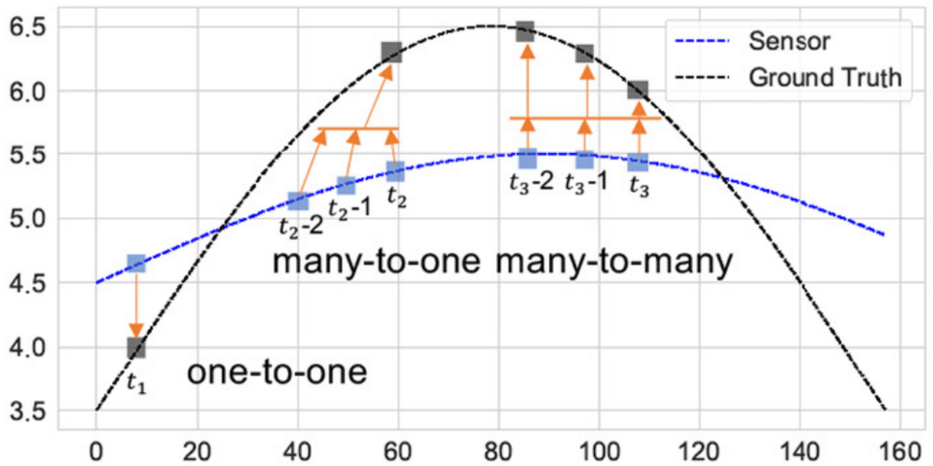
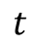
Background | Existing Methods | Insight ! | Framework Design | Experiments | Take away message
One-to-one calibration
Calibrated result
Raw data
$$t$$
Utilize measurements at a single time step to predict a calibrated sensor value for the same time step
Notes:
Several methods utilize feature vectors measured by a low-cost sensor in a time step to calibrate the sensor measurement at the same time step, which is refer to one-to-one calibration.

Slide 6
Background | Existing Methods | Insight ! | Framework Design | Experiments | Take away message
Many-to-one calibration
Calibrated result
Raw data
$$t$$
Utilizes measurements in recent past to capture measured phenomena and the temporal dynamics
Notes:
The recent methods include the use of measurements from the recent past measured by a low-cost sensor to better capture the measured phenomena and the temporal dynamics of the environment, we refer to these methods as many-to-one calibration.

Slide 7
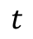
Background | Existing Methods | Insight ! | Framework Design | Experiments | Take away message
Many-to-Many calibration
Multiple calibrated values
Calibrated result
Raw data
$$t$$
Utilizes measurements in recent past and near future to calibrating low-cost measurements
Notes:
The more recent methods is many-to-many calibration, which uses feature vectors from both the recent past and the close future.

Slide 8
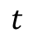
Background | Existing Methods | Insight ! | Framework Design | Experiments | Take away message
Many-to-Many calibration
Multiple calibrated values
Calibrated result
Raw data
$$t$$
Providing immediate calibration with its gradual refinement as further measurements become available
Notes:
This process involves the provision of prompt calibration while subsequently refining it in a gradual manner as additional measurements are obtained, which yields state-of-the-art performance.

Slide 9
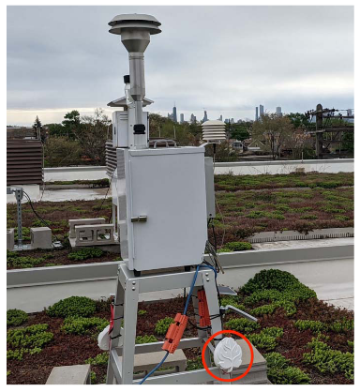
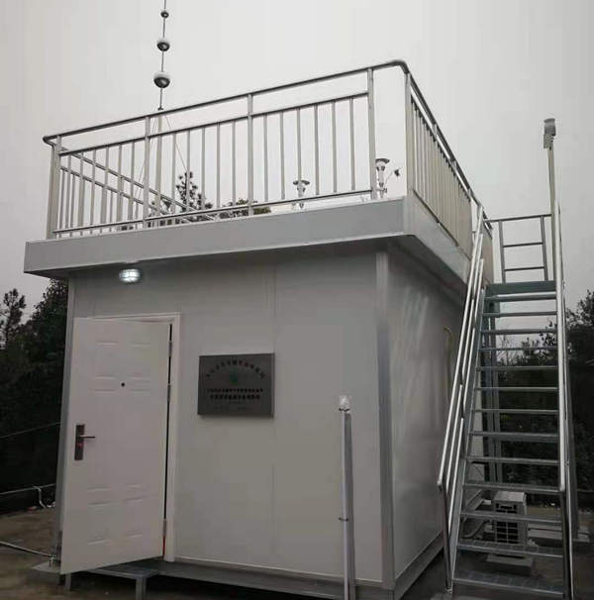
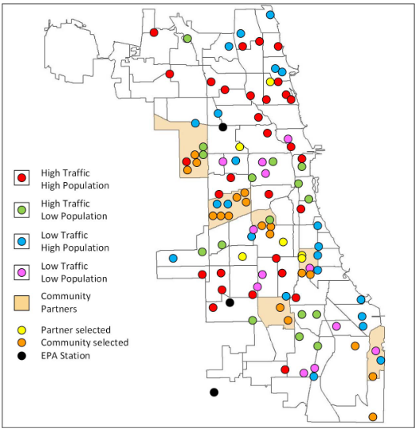
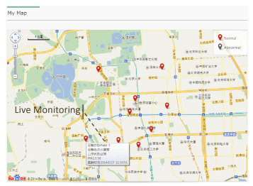
Background | Existing Methods | Insight ! | Framework Design | Experiments | Take away message
Existing Methods
However, all these methods are data-hungry, and it’s hard to collect sufficient data
Reason 1
Reason 2
Sparsely distributed monitoring stations
Various combinations of sensors and usage scenarios
Notes:
The above-mentioned methods requires a large amount of labeled data to train the calibration model.
However, this’s not possible in real-world scenarios to collect sufficient data due to the following reasons.
First of all, the ground truth only exists in a small number of sparsely distributed monitoring stations, making it expensive and time-consuming to collect sufficient training data.
Second, the diversity of sensor models and usage scenarios leads to the need for labeled data under various conditions in order to obtain a generalized model.

Slide 10
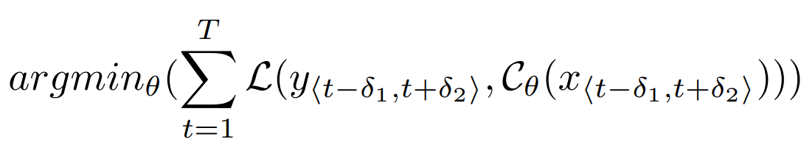
Background | Existing Methods | Insight ! | Framework Design | Experiments | Take away message
Research problem
How to scale data-driven system to sensing calibration with limited labeled data?
In mathematical form, how to minimize the following loss function with limited labeled data?
Loss function
Ground Truth
Calibration model
Measurement
Notes:
This paper tries to address the research problem: How to scale the data-driven system to large-scale environment sensing calibration with limited labeled data ?

Slide 11
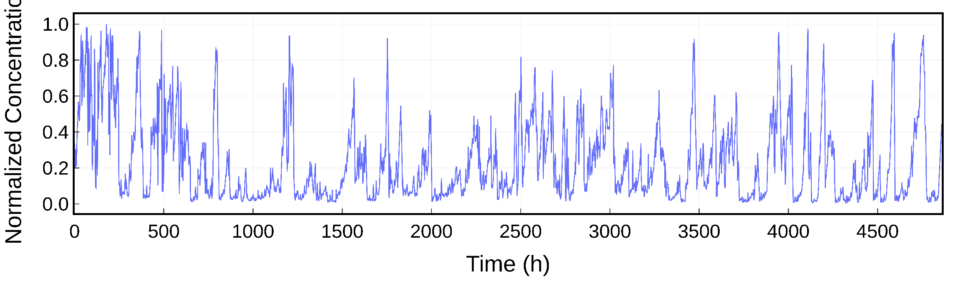
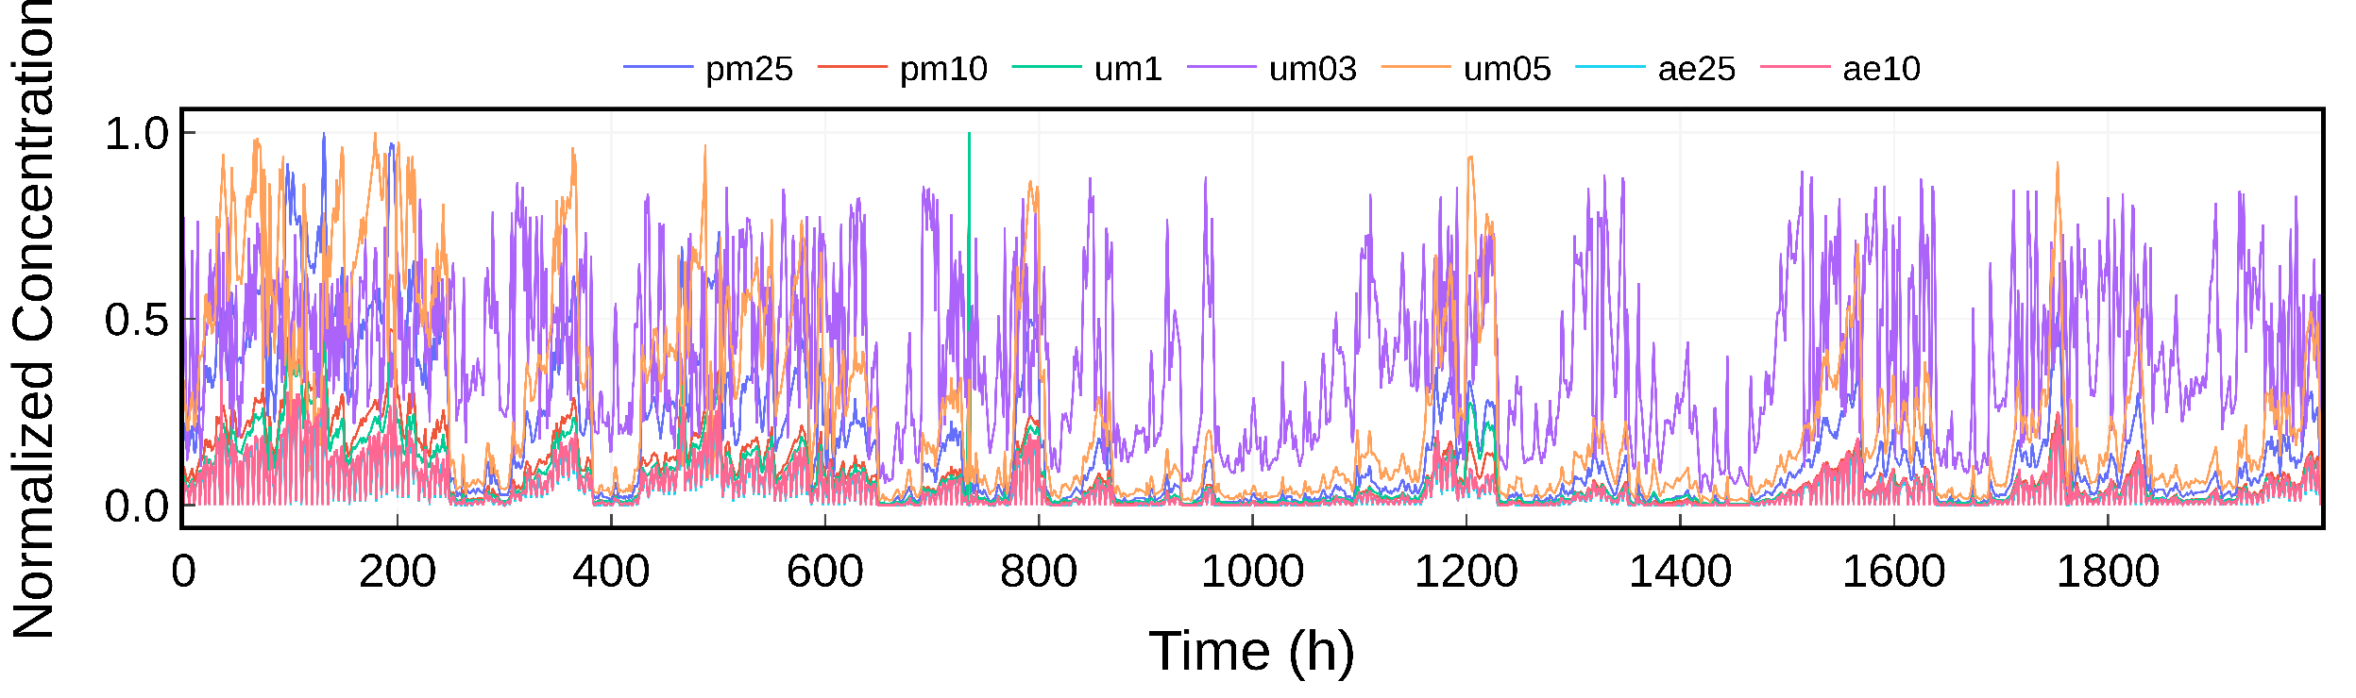
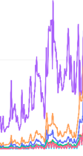
Background | Existing Methods | Insight ! | Framework Design | Experiments | Take away message
Observation: time- and spatial-invariant knowledge
Temporal dependencies of the measurement series
Correlation between multiple pollutants measurements
Notes:
To address this problem, we find that there are time- and spatial-invariant knowledge shared among tasks, such as the temporal dependencies of the measurement series and the correlation between multiple pollutants, which can be utilized to improve the calibration performance.

Slide 12
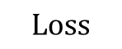
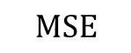
Background | Existing Methods | Insight ! | Framework Design | Experiments | Take away message
Framework Overview
1. Self-supervised learning phase
Unlabeled measurement
Masked measurement
Pre-train
Decoder
Reconstruct measurement
Masking
CaliFormer
$$MSE$$
Representation
2. Supervised learning phase
Reuse
Representation
Ground truth measurement
Labeled measurement
Fine-tune
Decoder
Calibrated measurement
CaliFormer
$$Loss$$
Notes:
To utilize these features, we presents a calibration system that utilizes a representation learning model CaliFormer to extract these time- and spatial-invariant knowledge shared among tasks through self-supervised learning leveraging a large amount of unlabeled data. The acquired representations can be employed to train a task-specific inference model with a limited amount of labeled data in the supervised learning phase.

Slide 13
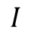
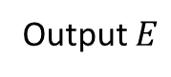
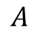
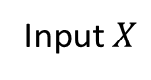
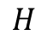
Background | Existing Methods | Insight ! | Framework Design | Experiments | Take away message
CaliFormer: Representation Learning Model
CaliFormer
~
$$I$$
$$H$$
$$A$$
Input $X$
Output $E$
Layer
norm
~
Position embedding
Multi-head Attention
MLP
Inspired by the efficiency of the Transformer in sequence-to-sequence prediction tasks
Notes:
Now our problem is how to extract representation from unlabeled sensor measurement? Contemporary self-supervised learning methodologies lack the requisite techniques for processing multi-modal sensor data, rendering them unsuitable for sensor measurements. Inspired by the efficiency of the Transformer in sequence-to-sequence prediction tasks, we propose a Transformer encoder-based model CaliFormer to deal with multi-modal sensor measurements

Slide 14
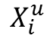
Background | Existing Methods | Insight ! | Framework Design | Experiments | Take away message
The Self-supervised Learning Phase
Unlabeled Measurements
$$X_{i}^{u}$$
Masking
Notes:
An auxiliary mission of reconstructing the sensor measurement sequence is then established to train CaliFormer and pre-train decoder together effectively.
In this process, the sensor measurements are masked at first.

Slide 15
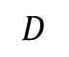
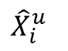
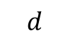
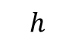
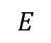
Background | Existing Methods | Insight ! | Framework Design | Experiments | Take away message
The Self-supervised Learning Phase
Unlabeled Measurements
$$X_{i}^{u}$$
Pre-train decoder
$${\hat{X}}_{i}^{u}$$
$$E$$
$$D$$
Masking
$$h$$
$$d$$
CaliFormer
MLP
Layer norm
Notes:
The CaliFormer and pre-train decoder are trained to reconstruct the masked pieces.

Slide 16

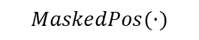
Background | Existing Methods | Insight ! | Framework Design | Experiments | Take away message
The Self-supervised Learning Phase
Unlabeled Measurements
$$X_{i}^{u}$$
Pre-train decoder
$${\hat{X}}_{i}^{u}$$
$$E$$
$$D$$
Masking
$$h$$
$$d$$
CaliFormer
$$MaskedPos(·)$$
$$MaskedPos(·)$$
$$MSE loss$$
$$MSE(MaskedPos(X_{i}^{u} ),MaskedPos( {\hat{X}}_{i}^{u} ))$$
MLP
Layer norm
Notes:
We utilize MSE of masked pieces to train the model. With this process, the CaliFormer learns the temporal relationship in sensor measurements and Correlation between multiple pollutants.

Slide 17
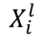
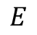
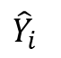
Background | Existing Methods | Insight ! | Framework Design | Experiments | Take away message
The Supervised Learning Phase
Labeled Measurements
$$X_{i}^{l}$$
Fine-tune decoder
$$E$$
Flatten layer
CaliFormer
Dropout
$${\hat{Y}}_{i}$$
Frozen
MLP
Multi-head Attention
Notes:
Subsequently, the fine-tune decoder is trained with parameter-frozen CaliFormer on limited labeled data.

Slide 18
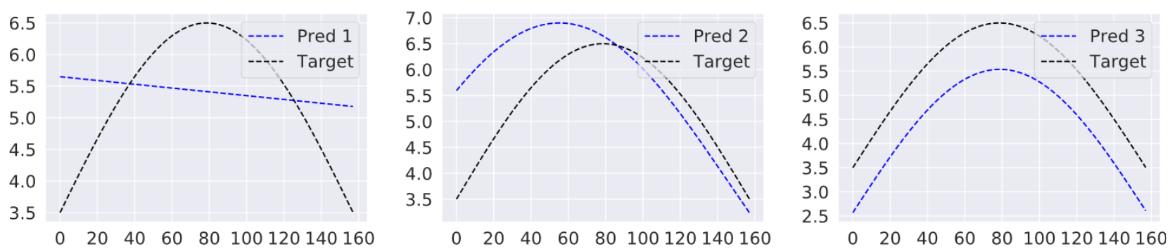
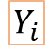
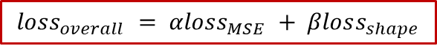
Background | Existing Methods | Insight ! | Framework Design | Experiments | Take away message
The Supervised Learning Phase
Labeled Measurements
$$X_{i}^{l}$$
Fine-tune decoder
$$E$$
Flatten layer
CaliFormer
Dropout
$${\hat{Y}}_{i}$$
Frozen
$$Y_{i}$$
$$loss_{overall} = αloss_{MSE} + βloss_{shape}$$
Ground truth
MLP
Multi-head Attention
$α,β$: adjustable trade-off coefficient to balance the importance of two parts of the loss function
Notes:
The MSE and the difference in shape are utilize to train the model, in which alpha and beta balances the importance of two parts of the loss function The CaliFormer and fine-tune decoder are then used to calibrate the sensor measurements.

Slide 19
Background | Existing Methods | Insight ! | Framework Design | Experiments | Take away message
Experiments Setup
Datasets: Beijing Data Set, which comprise PM2.5 (particles of diameter less than 2.5µm) measurements at seven locations in Beijing. The sensor reports seven feature measurements at a time which are utilized to train the models. There are 60450 samples used in the experiments.
Preprocessing: We split the sensor measurements into the training (60%), validation (20%), and test (20%) sets. The training set is then split into the labeled set (1%) and unlabeled set(99%).
Methods in comparison: (1) Naïve; (2) SensorFormer (SF) : To the best of our knowledge, SF is the state-of-the-art many-to-many calibration method, which is based on the Transformer model; (3) SensorFormer-mo (SF-mo). SF-mo is the many-to-one version of state-of-the-art calibration method, which means this method do not use lossshape in the loss function. (4) SensorFormer-oo (SF-oo) [7]. SF-oo is the one-to-one version of state-of-the-art calibration method. (5) CaliFormer-FT. CaliFormer-FT stands for CaliFormer with the fine-tune decoder.
Metric: Mean Absolute Error (MAE)
Notes:
To demonstrate the effectiveness of our calibration system, we conduct experiments compared with SOTA methods on a dataset including PM2.5 measured by low-cost sensors.

Slide 20
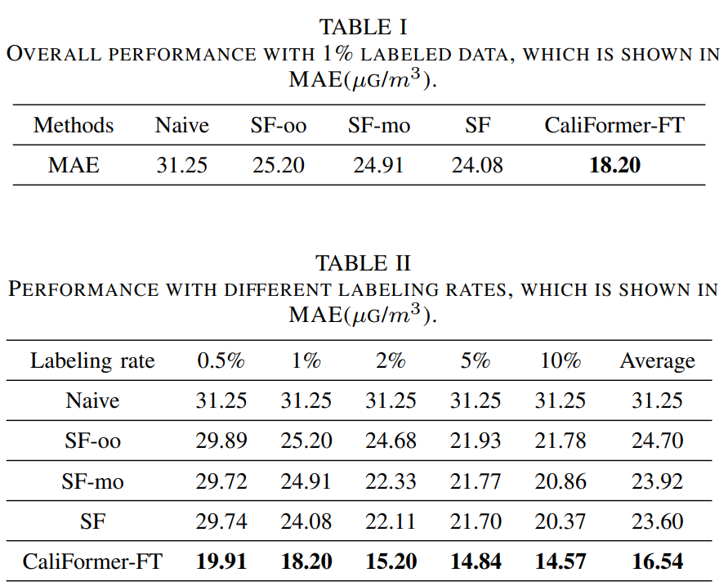
Background | Existing Methods | Insight ! | Framework Design | Experiments | Take away message
Overall Performance
Overall performances: with only 1% of the labeled dataset. The CaliFormer-FT outperforms the state-of-the-art method SF by 25%. This is because the CaliFormer extracts effective representation from unlabeled data.
Varying labeling rate: the performance with different labeling rates, varying from 0.5% to 10%. The fine-tune decoder achieve better performance with learned CaliFormer. The gain is significant with low labeling rate.

Slide 21
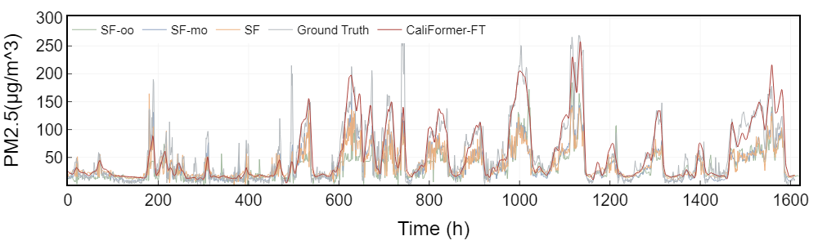
Background | Existing Methods | Insight ! | Framework Design | Experiments | Take away message
Calibration results
Compared to other baselines, CaliFormer-FT performs better, especially during the peak periods

Slide 22
Background | Existing Methods | Insight ! | Framework Design | Experiments | Take away message
Observations and Contributions
To the best of our knowledge, CaliFormer is the first attempt to incorporate self-supervised learning into sensor calibration. Compared to prior research, the CaliFormer necessitates significantly less labeled data, which constitutes a tangible advancement toward practical in-field sensor calibration.
Drawing inspiration from the Transformer architecture, we develop the CaliFormer to process multi-modal sensor data. Additionally, we propose a set of enhancements in pre-training methodology and model architecture to facilitate the effective training of the calibration model.
A prototype system is developed and experimentally compared with state-of-the-art methods. Extensive evaluation results demonstrate the effectiveness of the CaliFormer based calibration system.

Slide 23
Thank you for listening
Haoyang Wang, Yuhan Cheng, Baining Zhao
Lab 2C

Slide 24
Background | Existing Methods | Insight ! | Framework Design | Experiments | Take away message
The Self-supervised Learning Phase
Unlabeled Measurements
$$X_{i}^{u}$$
Pre-train decoder
$${\hat{X}}_{i}^{u}$$
$$E$$
$$D$$
Masking
$$h$$
$$d$$
CaliFormer
$$MaskedPos(·)$$
$$MaskedPos(·)$$
MLP
Layer norm

